Slide 1


ONLINE LEARNING PLATFORM TEAM TECHTITANS
MEMBERS:
Abhippsa Subhadarshini(2022BCSE07AED238)
Aashish Kumar(2022BIFT07AED012 )
Deepak Kumar(2022BCSE07AED134)
Yogesh Reddy(2022BIFT07AED026)

Slide 2
PROBLEM STATEMENT
Online Learning Platform
Problem: Create a platform where instructors can upload courses, and students can enroll in , and complete courses.
Requirements: Front-end: Course browsing, enrolling, and video streaming interface.
Back-end: Django for course management, progress tracking, and user enrolment.
Database: Store users, courses, and student progress.
Video Streaming: Integrate with a cloud video streaming service .

Slide 3
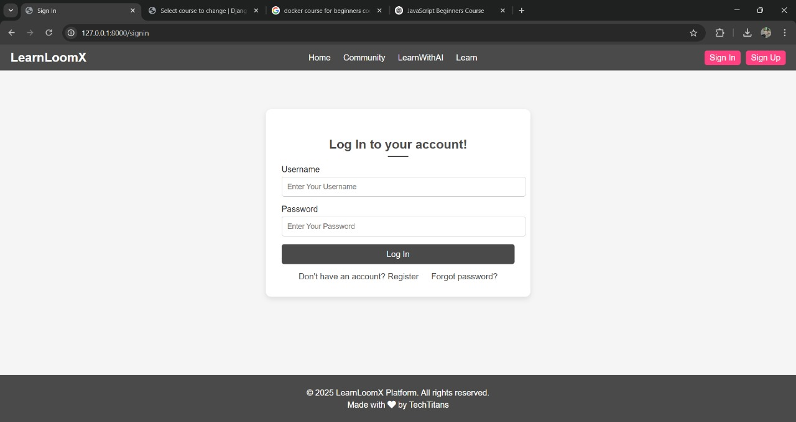
Login Page
Purpose: Allows existing users to access their accounts.
Key Features:
Input Fields: Email/username and password fields.
Login Button: To authenticate and direct the user to their dashboard or course page.
Forgot Password: An option to recover lost credentials.
Sign-Up Link: A link for new users to create an account.
User Flow: Returning users access their learning materials and progress.

Slide 4
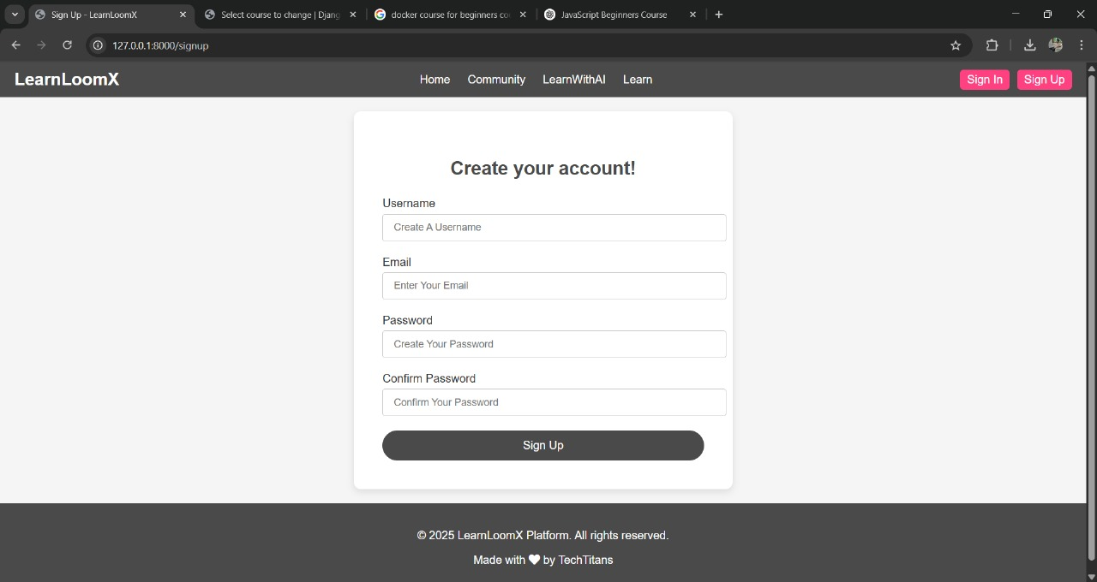
Create Your Account
Purpose: Onboard new users by collecting their details.
Key Features:
Input Fields: Name, email, password, and possibly profile details (e.g., role or interests).
Sign-Up Button: To submit the form and create an account.
Terms & Conditions Checkbox: Ensures legal compliance.
Login Redirect: For users who already have an account.
User Flow: New users register and proceed to explore the platform.

Slide 5
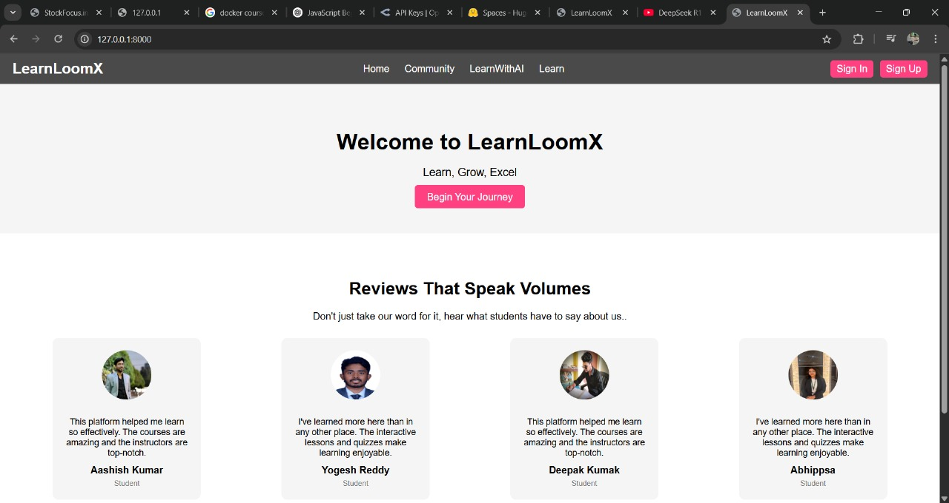
Home Page
Purpose: The main entry point where visitors learn about your platform.
Key Features:
Hero Section: Likely includes a catchy headline, platform description, and a call-to-action (CTA) button (e.g., "Get Started" or "Sign Up").
Navigation Menu: Links to key sections like courses, login, community, and support.
Highlight Section: It may display featured courses, testimonials, or platform benefits.
User Flow: This is the first impression, aiming to convert visitors into registered users.

Slide 6
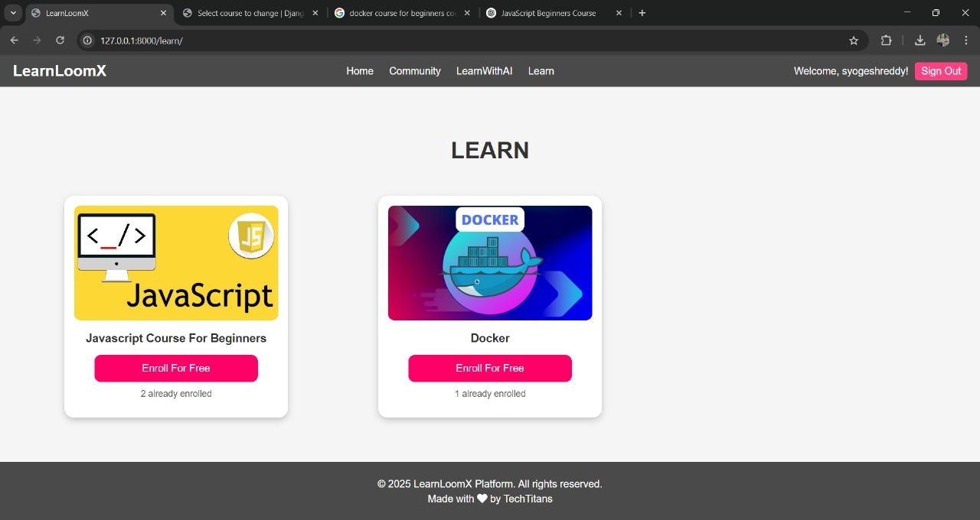
Learn Page
Course Catalog & Previews: Browse courses with thumbnails, titles, and brief descriptions, leading to detailed course pages.
Categories & Filters: Sort courses by subject, level, or rating for easy navigation.
Lessons & Progress Tracker: Structured modules with a tracker showing completion status.
Enroll & Start Buttons: Seamlessly begin or continue learning with clear call-to-action buttons.

Slide 7
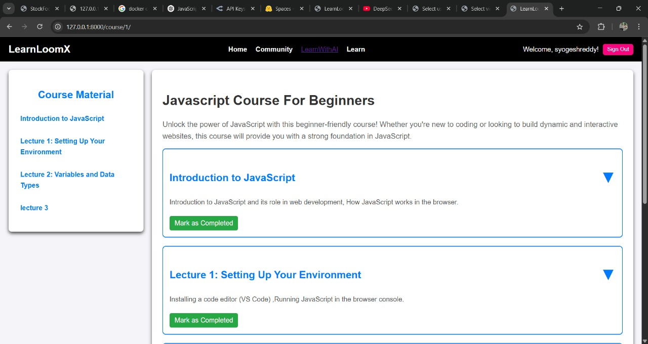

Slide 8
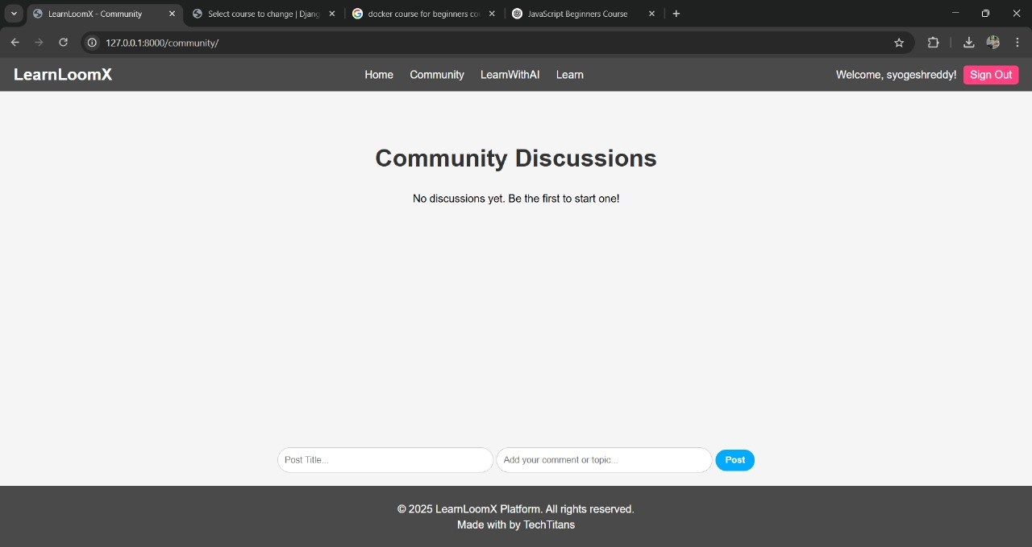
Discussion Forums: Post questions, share insights, and collaborate through threaded conversations.
User Profiles & Replies: Display user details and enable easy interaction with comments and replies.
Search & Filter: Quickly find relevant topics or threads for efficient navigation.

Slide 9
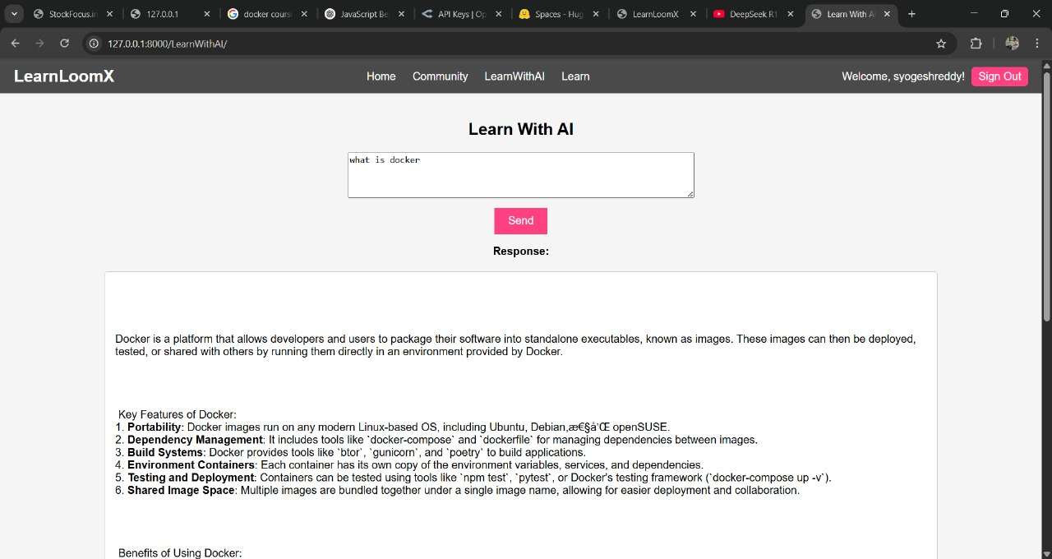
LEARN WITH AI
Ollama Integration:
The platform uses Ollama as the backend AI engine to process and interpret user queries.
DeepSeek Access v1.5:
Ollama is integrated with DeepSeek Access v1.5, which enables it to retrieve accurate and relevant information for the questions asked.
Real-time AI Responses:
The setup generates real-time, AI-powered answers by analyzing the input and delivering structured, clear responses.
Enhanced Learning Experience:
This integration boosts LearnLoomX's efficiency by providing quick, reliable, and informative answers, enhancing the user experience.

Slide 10
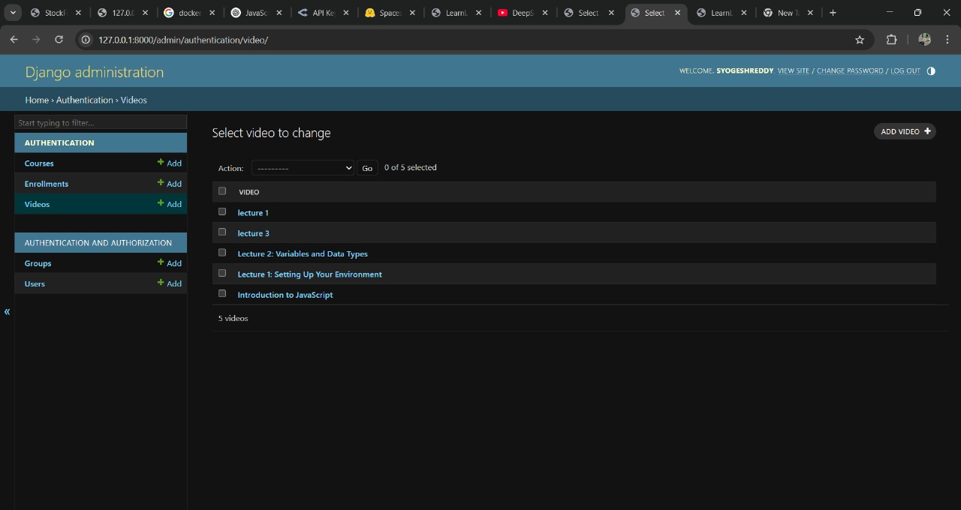
ADMIN PAGE
Video Management: Displays a list of videos with options to add, edit, or delete them.
CRUD Operations: Perform bulk actions (Add, Edit, Delete) on videos.
Authentication & Authorization: Manage courses, enrollments, groups, and users.
Admin Interface: Automatically generated by Django based on models.

Slide 11
WHY OUR PROJECT?
Free Access to Quality Courses
The website provides free access to various courses, allowing users to learn JavaScript, Docker, and other technologies without any cost.
It offers beginner-friendly content, making it suitable for learners at all levels.
User-Friendly Interface
The website features a clean and intuitive interface, making navigation seamless.
The layout includes easy access to the homepage, community discussions, and learning modules, enhancing the user experience.
Community Support with Co-Pilot
Users can participate in community discussions, ask doubts, and get their queries resolved through the built-in co-pilot feature.
This fosters collaboration and helps learners gain deeper insights through peer interaction.
Efficient User Management
The platform offers a streamlined account management system with secure sign-in and registration options.
Users can mark course progress as "Completed," helping them track their learning journey effectively.

Slide 12


